Slide 1

Project
Optimization
PROJECT IMPLEMENTATION SCHEDULING(topic24)
Nguyễn Huy Hoàng 20214959
Nguyễn Viết Quý Anh 20214947
Phạm Quang Trung 20214935

Slide 2



Content
1. Project requirement
2. Modeling
3. Analysis

Slide 3

Project Requirement

Slide 4
The investor need to complete N tasks by M groups of workers
Group j can start the task at time s(j)
c(i,j) is the cost for renting group j do task i
Each task i can finished by a group in set W(i) and completion time is d(i)
Between N tasks have a different priority while task i must be done first before starting task j
Each groups can only do one task at a time and when starting a task, they have to complete it without stop to do other task
Make a schedule to finish N task in which :
+) Completion time is minimized
+) Max total cost paying for a group worker is minimized

Slide 5

Input Specification

Slide 6
6 3
5 1 3 0
7 1 2 0
12 2 3 0
3 1 3 0
10 1 2 0
0 0 0
2
1 4
2 6
4 3 5
3 4 1
1 2 1
2 3 2
3 3 2
5 6 2
->N = 5: number of tasks; M = 3: number of workers
-> d(i): completion time; and workers who can do task i; end by 0
->s(j): the time that worker j can start his work
->K: number of constraints between tasks
-> pairs of (i,j) such that task i and j while task i must be finished first
-> c[i][j]: cost for renting worker j do task I

Slide 7
Problem Formulation

Slide 8
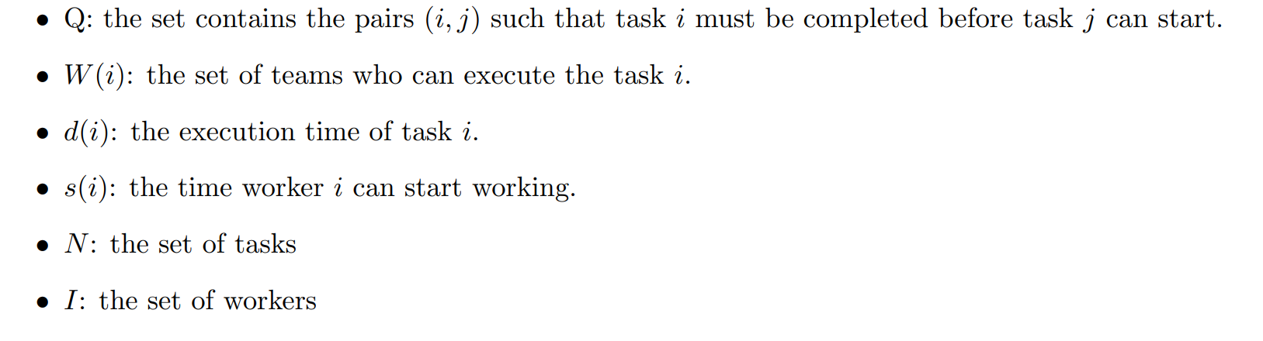
Denotation

Slide 9
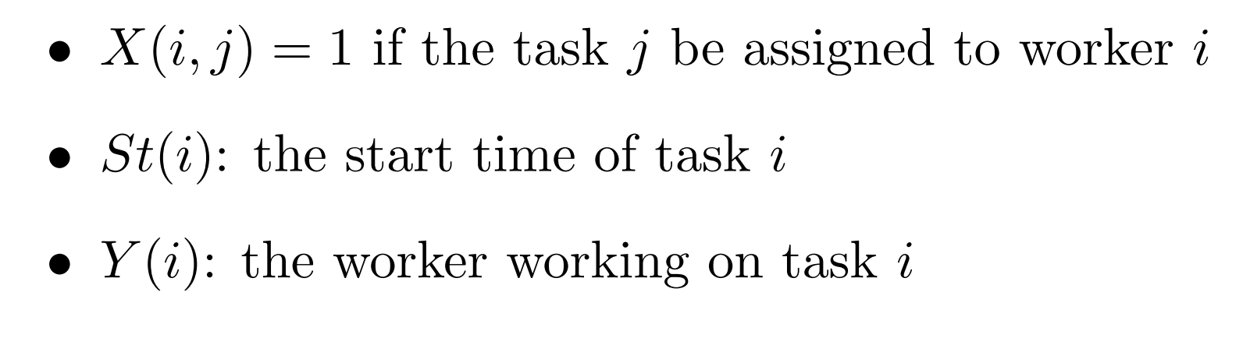
Variables

Slide 10
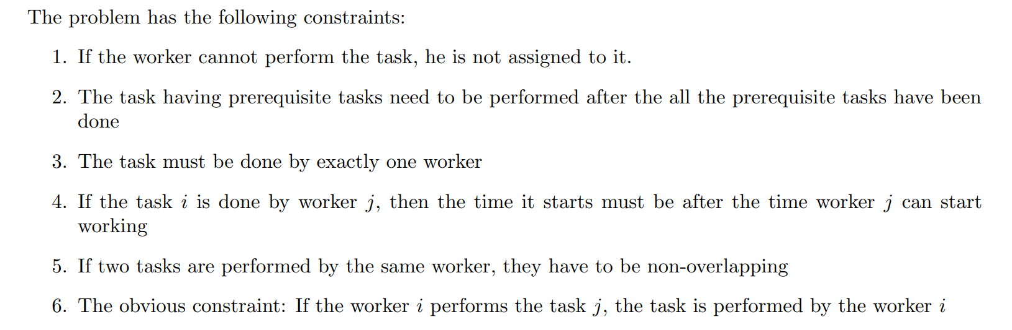
Constraints

Slide 11
Greedy Algorithm
The greedy algorithm will have a list to store all the tasks having all their prerequisites sorted. The tasks in the list will then be sorted by their execution time. The longest task will be sorted first to the worker with the soonest available time .

Slide 12
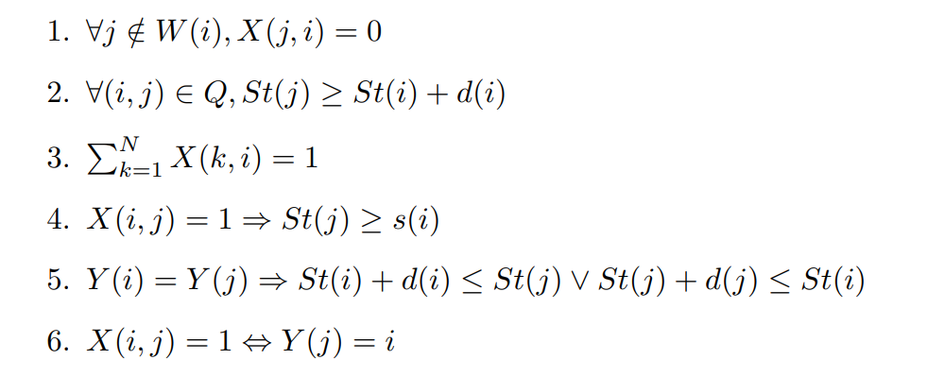
CP model

Slide 13
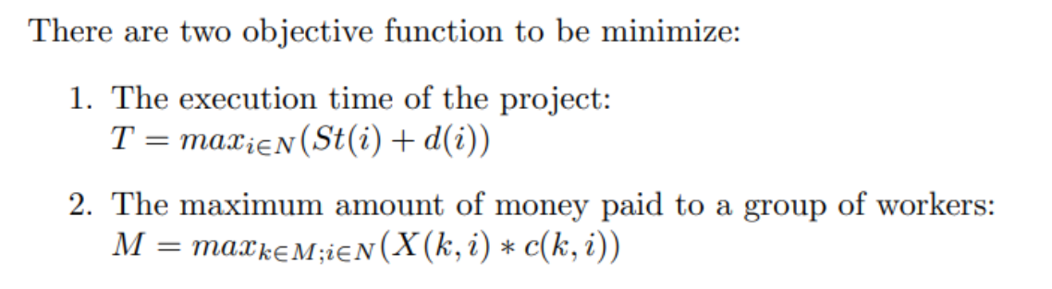
CP model objective function

Slide 14
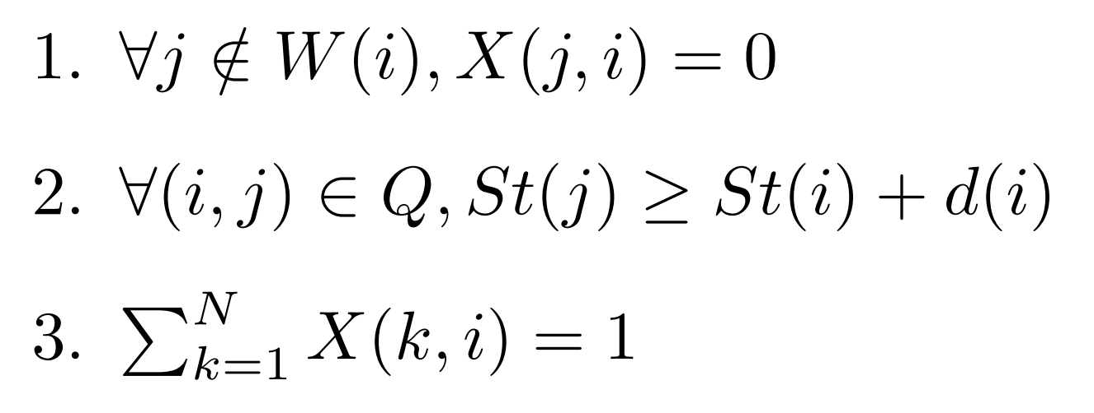
MIP model

Slide 15
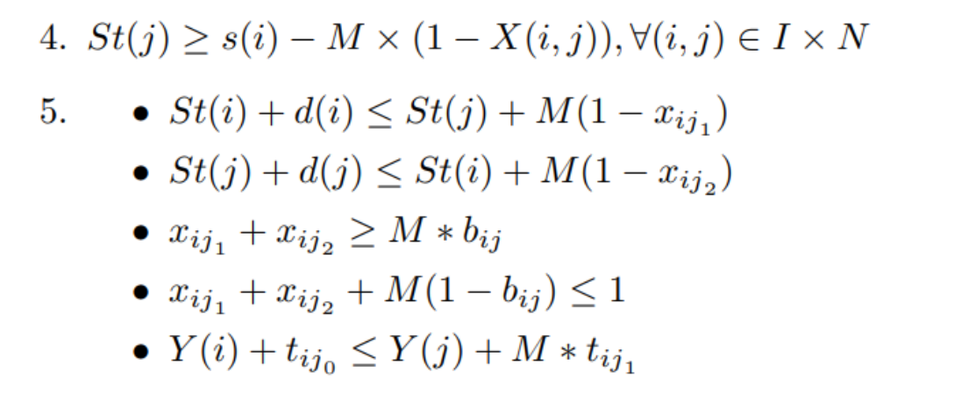
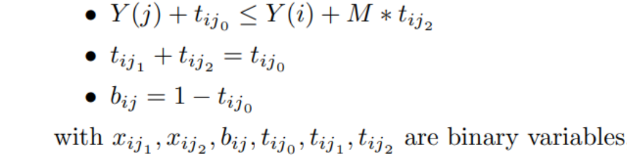
MIP model

Slide 16
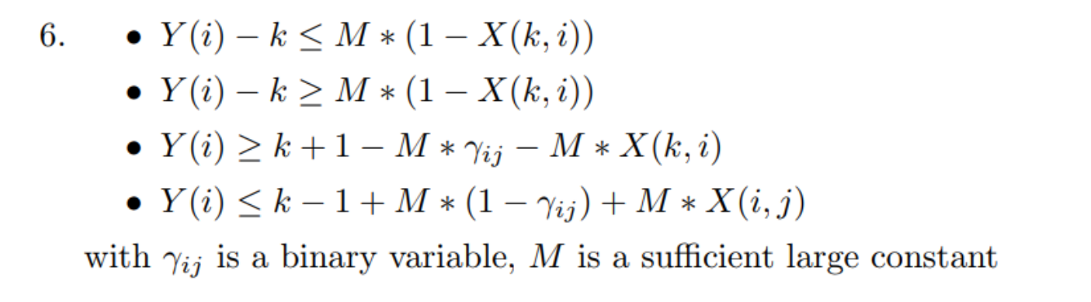
MIP model

Slide 17
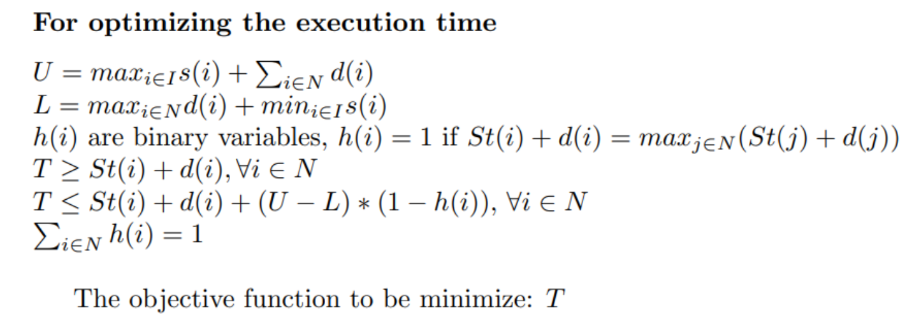
MIP model objective function

Slide 18
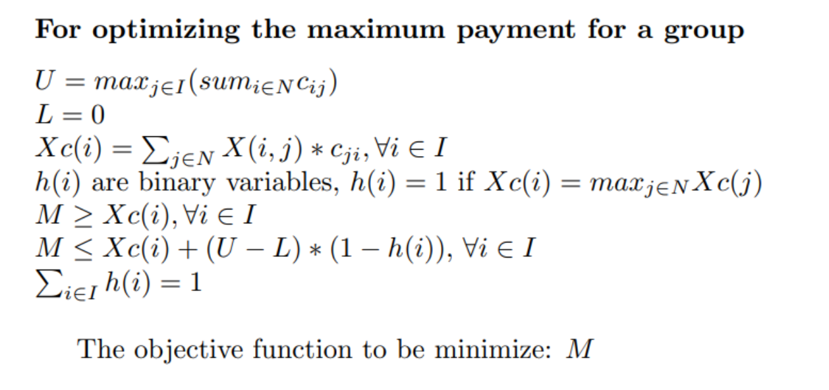
MIP model objective function

Slide 19
Comparison between CP and MIP

Slide 20
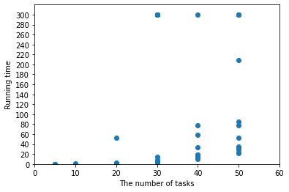
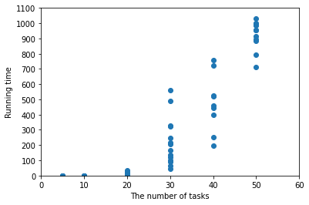
Comparison
We collected 56 input files to test the efficiency of 2 models, each dot represents a test case
MIP model
CP model

Slide 21
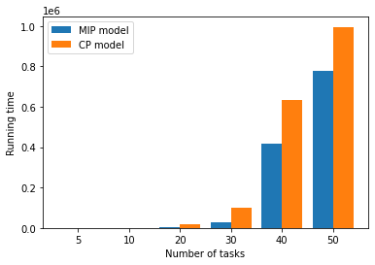
Comparison
MIP model has the running time smaller than that of CP on all 56 test.
The MIP model can work with real input.
The CP model can optimize both execution time and the maximum payment for a group of worker.

Slide 22
List of task
Phạm Quang Trung
MIP model (100%)
Greedy Algorithm (100%)
Report (100%)
Data Analysis (10%)
Slide (30%)
Nguyễn Huy Hoàng
CP model (50%)
Data Analysis (90%)
Nguyễn Viết Quý Anh
CP model (50%)
Slide (70%)

Slide 23
Thank you for your attention!!!
Do you have any questions for us?

